Slide 1
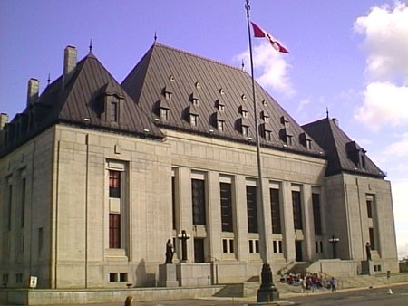
The Judicial Branch

Slide 2
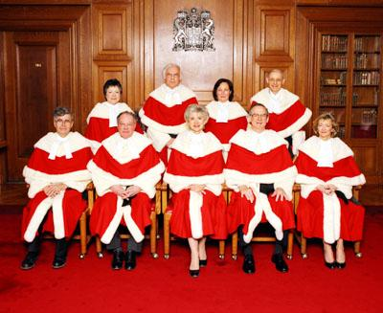
The court system functions independently of the executive and legislative branches – a check on possible abuses
All judges have the right of judicial review – the power to overturn (strike down) legislation that contravenes the constitution

Slide 3
Two views of the Judiciary: Judicial Restraint
Judges take a low key view of their powers
Interpret the law literally
If changes to the laws are necessary, defer to the executive and legislative

Slide 4
Two views of the Judiciary: Judicial Activism
Judges take a flexible view of their powers
Willing to interpret the law in a way that it can be adapted to changing circumstances

Slide 5
Canada’s Supreme Court
The highest court of appeal in the land
Consists of 9 judges appointed by the PM
3 from Quebec, 3 from Ontario, 2 from the West, 1 from the East
Gives its interpretation of how the Charter of Rights and Freedoms is applied in Canada
Settles jurisdictional disputes between federal and provincial government
Often asked to rule on the principles of a bill before it is passed

