Slide 1
The United Nations

Slide 2
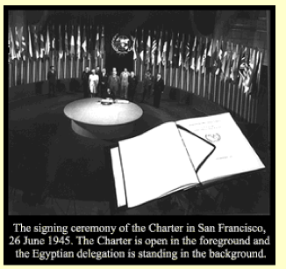
ORIGINS
established Oct 24, 1945 by 51 member states
for countries to work collaboratively for peace and development based on principles of justice, human dignity, and overall well- being of people
currently, 192 member states with equal vote
not a world government, but an association of sovereign states
carries moral weight of world opinion

Slide 3
Aims of the United Nations
To keep peace throughout the world.
To develop friendly relations between nations.
To work together to help people live better lives, to eliminate poverty, disease and illiteracy in the world, to stop environmental destruction and to encourage respect for each other's rights and freedoms.
To be a centre for helping nations achieve these aims.

Slide 4
Principles of the United Nations
All Member States have sovereign equality.
All Member States must obey the Charter.
Countries must try to settle their differences by peaceful means.
Countries must avoid using force or threatening to use force.
The UN may not interfere in the domestic affairs of any country.
Countries should try to assist the United Nations.

Slide 5
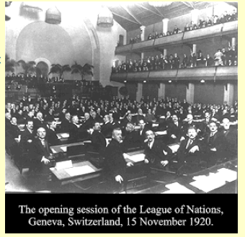
Predecessor
League of Nations
established after WWI
57 countries
Aims
To preserve the peace by defending member states from aggression through economic and military sanctions
To promote international cooperation in economic and social affairs
US never joined, major powers withdrew, unwillingness to issue sanctions and insufficient moral authority caused it to fail

Slide 6
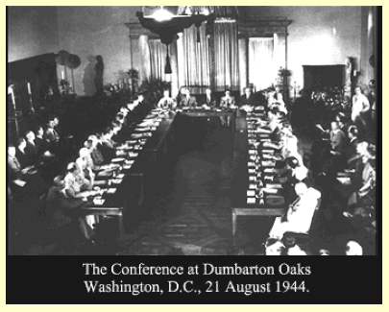
UN Charter
blueprint established 1944 by Britain, China, the US, and the USSR
June 1945 final text signed by 50 countries in San Francisco
the Leagues ideals and some of its structure were kept
the Leagues Council became the Security Council composed of five permanent members (victors of WWII) with veto power
a new organ, the Economic and Social Council created along with specialized agencies for labour, education, health, development, and environment
enshrined the Universal Declaration of Human Rights – context of international law

Slide 7
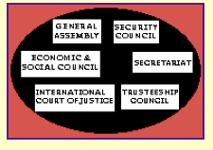
The UN System
actions to accept, fund, and carry out resolutions depend on the will of member states
resolutions by Security Council and ICJ, however, are legally binding
Specialized agencies are separate autonomous international organizations working with the UN and each other – they depend on funds by member states – and organize forums on international matters bringing NGOs, governments and media together. If international agreement achieved and signed, it is still up to each individual country to carry them out – moral weight of international community used to pressure them
http://www.un.org/en/aboutun/structure/index.shtml
UN Structure and Organization

